Slide 2

My Intro
I am Hamas Ur Rehman
Beta Microsoft Learn Student Ambassador
Technical Lead at Computer Cell
Have experience with ML/AI, Python etc.

Slide 3
Agenda
Checking out the vanilla GPT API
Downsides of just using the simple API
Learning about Langchain
Building a Research Paper Question Answer Bot
Vector Database over normal database
Giving ChatGPT internet access

Slide 4
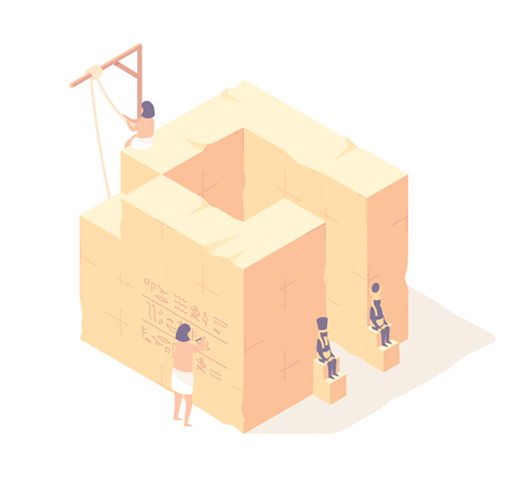
Checking out the vanilla GPT API

Slide 5
ChatGPT in your own programs
Idea Generator
Summarize text
Explain topics
Write code
An information bank

Slide 6
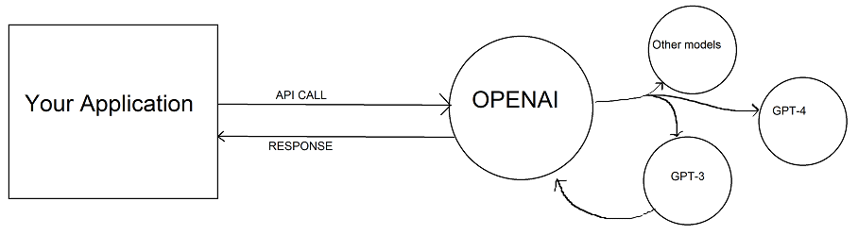
How to implement it

Slide 7
Limitations
Is not organization specific
Information cut off 2021
Inconsistent answers

Slide 8
Solutions
Finetuning the GPT models
Write better Prompts explaining your questions and giving data in the prompt

Slide 9
Learning about Langchain

Slide 10
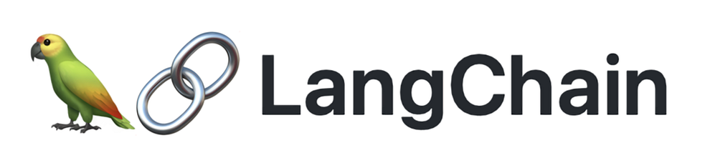
What is Langchain
LangChain is a framework that enables developers to build agents that can reason about problems and break them into smaller sub-tasks. With LangChain, we can introduce context and memory into completions by creating intermediate steps and chaining commands together

Slide 11
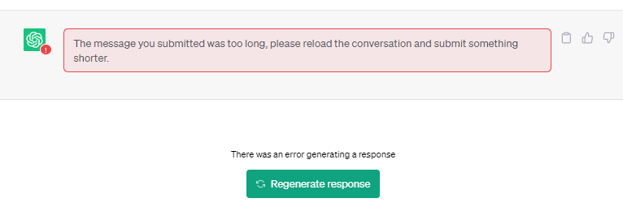

Slide 12
Building a Research Paper Question Answer Bot

Slide 13

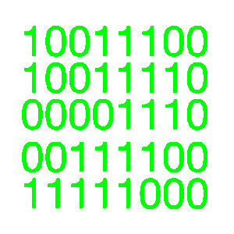
How Langchain can handle this

Slide 14
Vector database
Questions comes: What is a hydrogen fuel cell
EMBEDDINGS FUNCTION

Slide 15
Giving ChatGPT internet access

Slide 16
Why?
Well, ChatGPT was trained up to data until 2021

Slide 17
QUIZ

